Slide 1
Global Pension Risk Survey 2019
UK Results
12 September 2019

Slide 2

Your speakers
Matthew Arends
Alastair McIntosh
Emily McGuire

Slide 3
Agenda
Introduction
Long-term targets
Investment strategy
Managing benefits and risks
Hot topics: cyber risk and GMP equalisation
Notes:
Red:Agenda

Slide 4

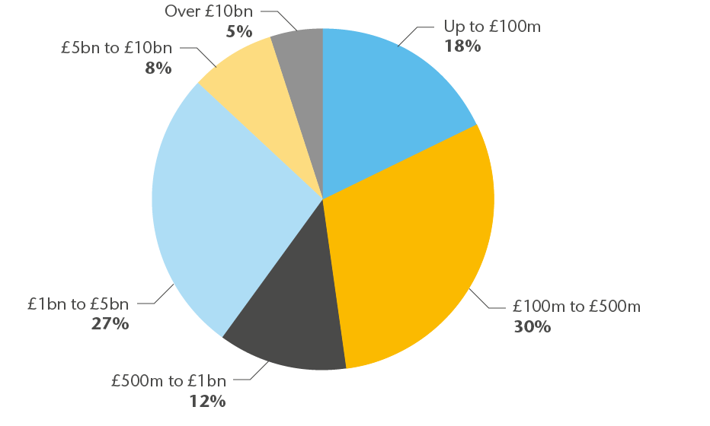
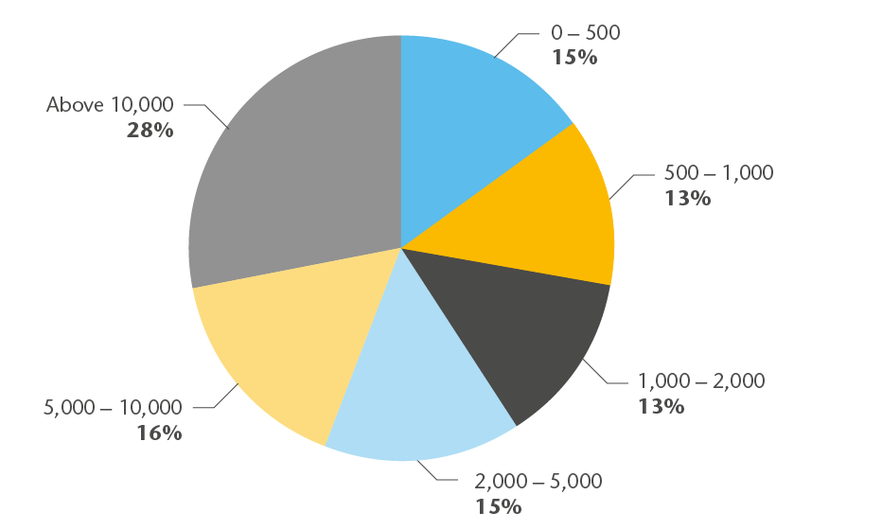

Introduction – respondents to the UK survey
Respondents based on scheme asset size
Respondents based on number of scheme members
Notes:
Red:Agenda

Slide 5
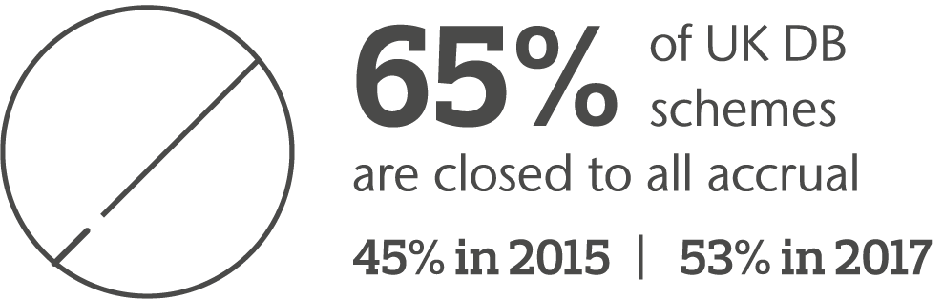
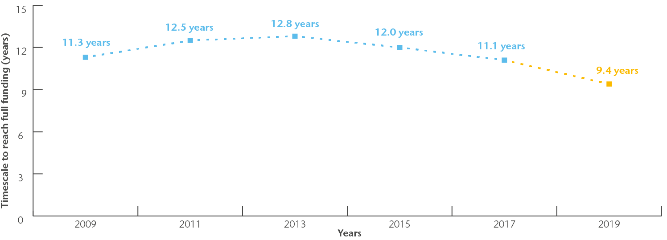
Rapidly maturing schemes – a key theme
Timescale to reach long-term target as reported in previous Global Pension Risk Surveys

Slide 6
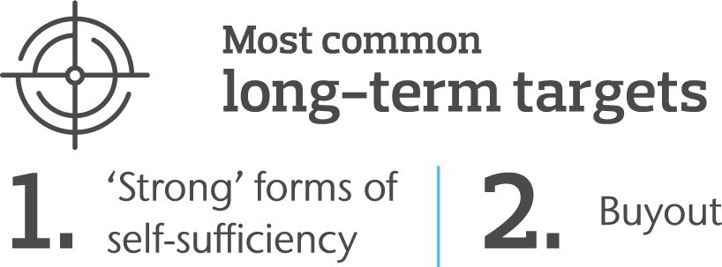
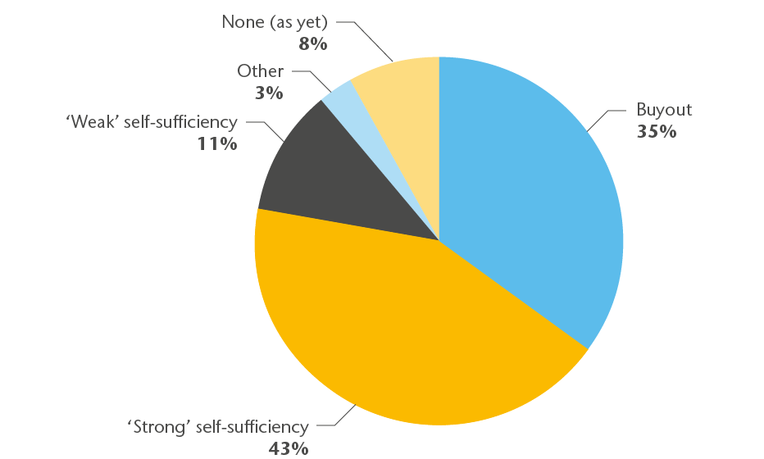
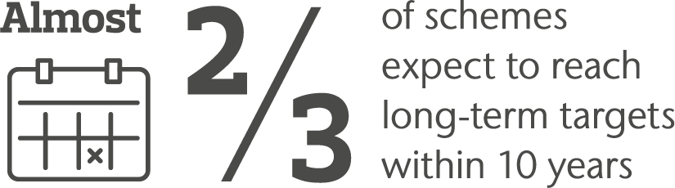


Long-term targets
Long-term targets

Slide 7
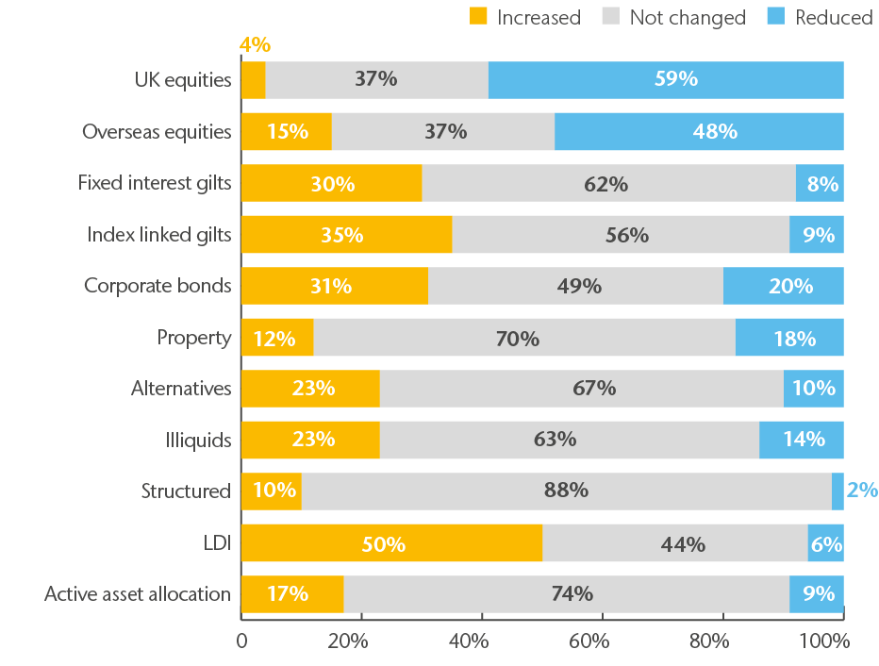
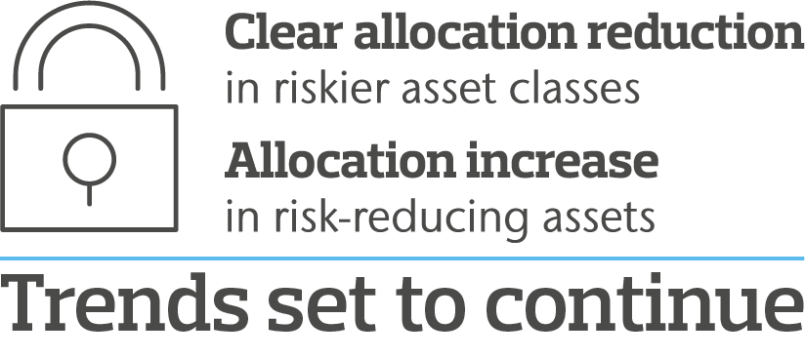
Investment – asset allocation movements
Actual investment changes over last 12 months

Slide 8
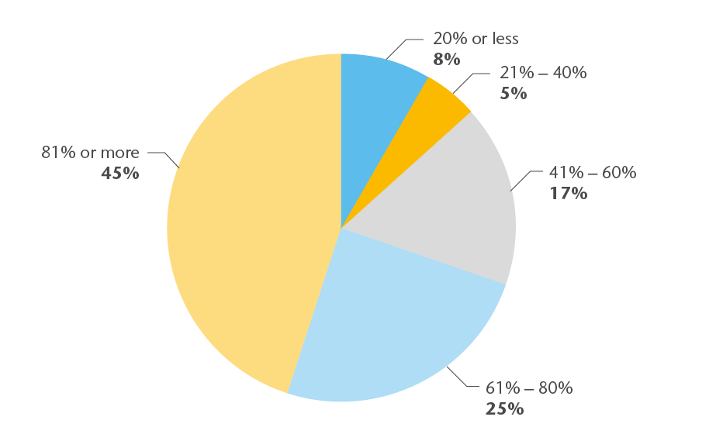
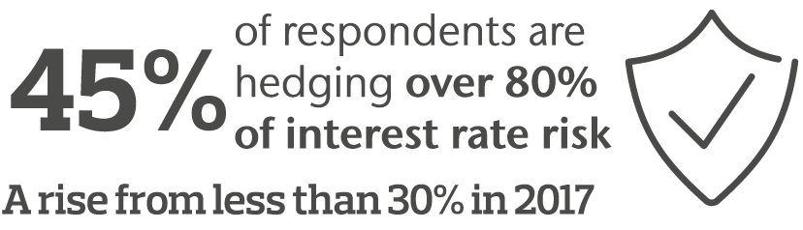
Investment – de-risking
Interest rate hedging ratios

Slide 9
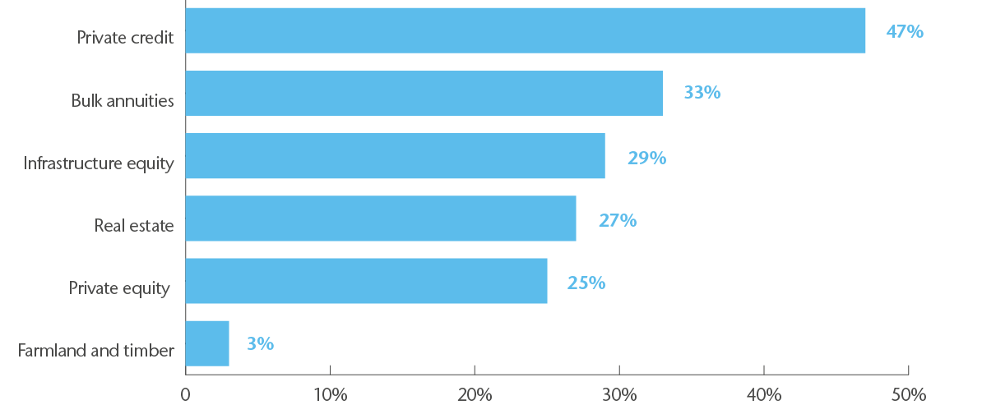
Investment – illiquids
Anticipated investments in illiquids

Slide 10
Investment – polling question
According to our survey, around ¼ of respondents delegate full fiduciary mandates.
Over the next 12 months is your scheme going to consider:
1
Already implemented a fiduciary mandate
2
Full fiduciary mandate
3
Partial fiduciary mandate
4
No plans to consider

Slide 11
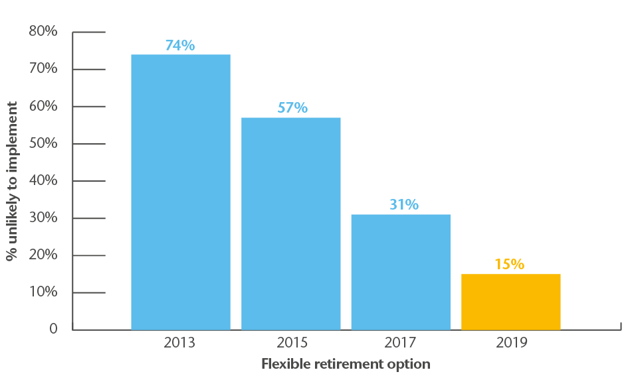

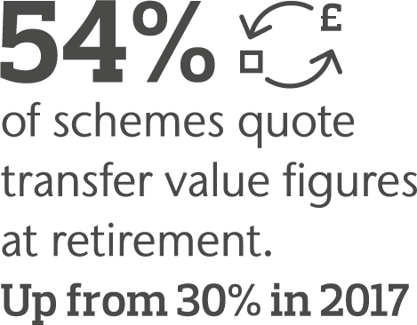
Managing benefits…
Changing attitudes to liability management
Flexible Retirement Option now
seen as part of normal service
Notes:
Discuss pensions dashboard

Slide 12
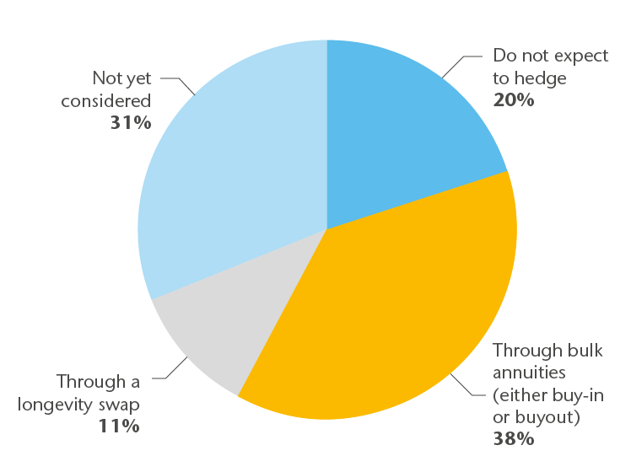
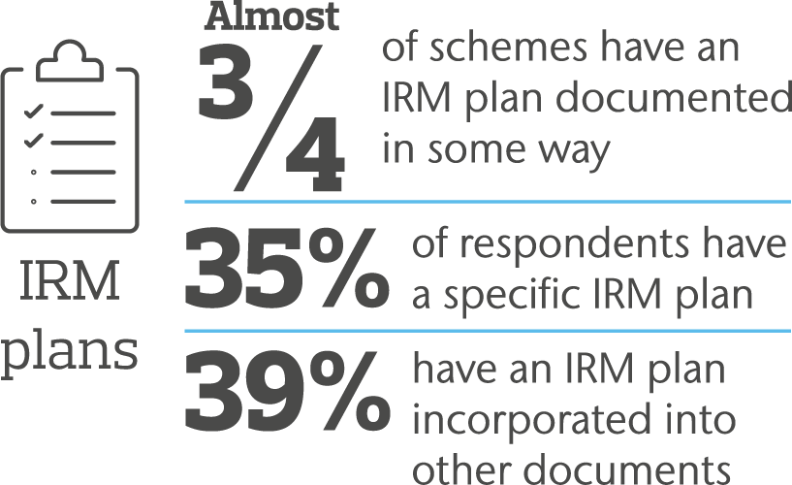
…and risks
Longevity risk management
IRM gaining traction
49% plan to buy annuities or longevity swap

Slide 13
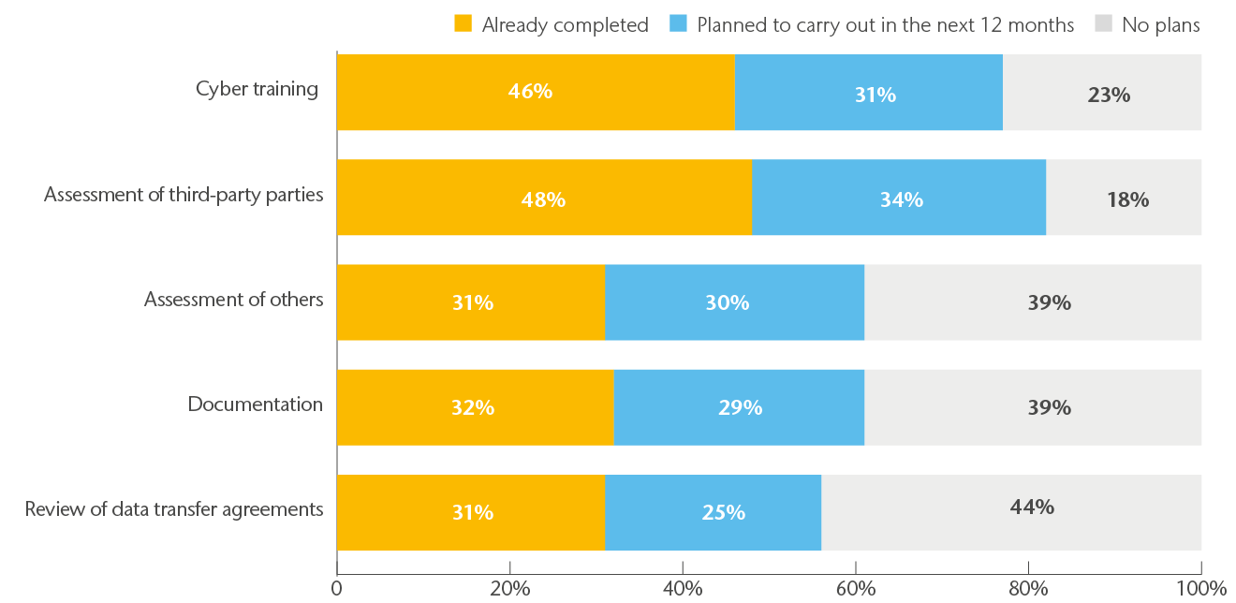

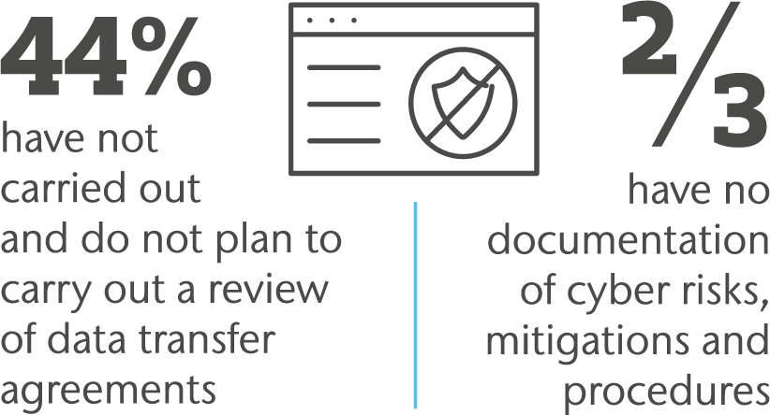
Cyber risk
Actions to prevent a cyber-incident

Slide 14
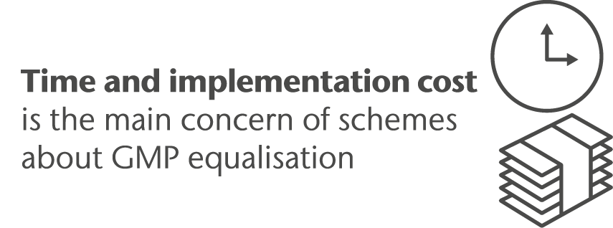
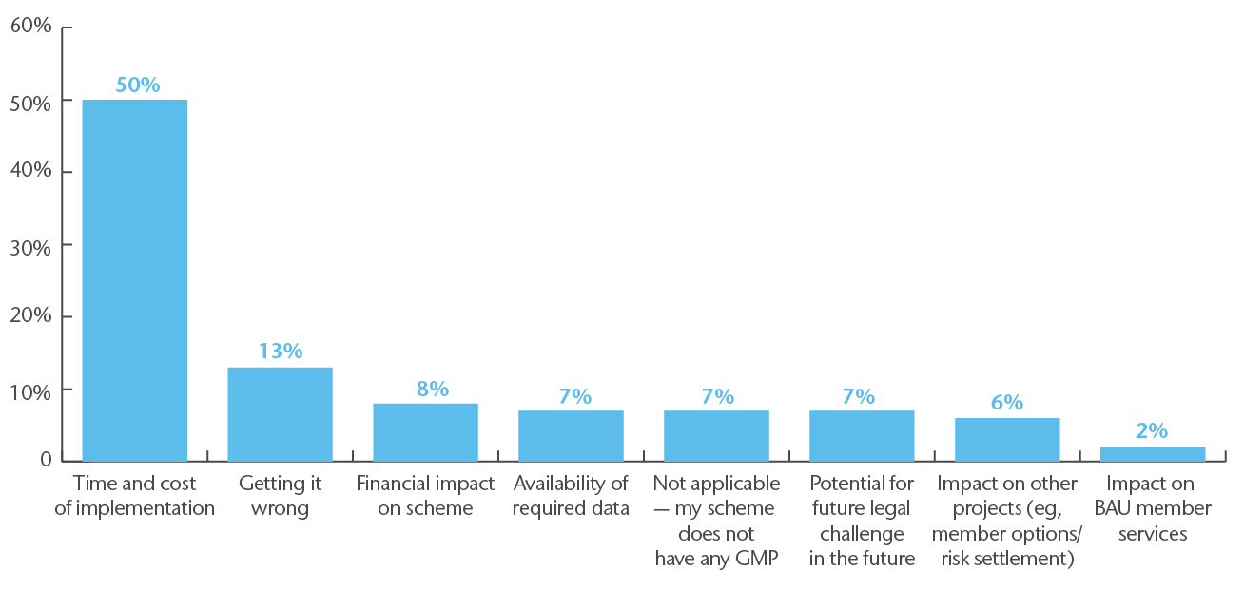

GMP equalisation
GMP equalisation – main concerns

Slide 15
GMP polling question
When do you want to go live with GMP equalisation?
1
Within the next year
2
2-3 years
3
4-5 years
4
>5 years
5
Don’t know or not applicable

Slide 16
Questions

Slide 17
Disclaimer
This document and any enclosures or attachments are prepared on the understanding that it is solely for the benefit of the addressee(s). Unless we provide express prior written consent, no part of this document should be reproduced, distributed or communicated to anyone else and, in providing this document, we do not accept or assume any responsibility for any other purpose or to anyone other than the addressee(s) of this document.
Notwithstanding the level of skill and care used in conducting due diligence into any organisation that is the subject of a rating in this document, it is not always possible to detect the negligence, fraud, or other misconduct of the organisation being assessed or any weaknesses in that organisation's systems and controls or operations.
This document and any due diligence conducted is based upon information available to us at the date of this document and takes no account of subsequent developments. In preparing this document we may have relied upon data supplied to us by third parties (including those that are the subject of due diligence) and therefore no warranty or guarantee of accuracy or completeness is provided. We cannot be held accountable for any error, omission or misrepresentation of any data provided to us by third parties (including those that are the subject of due diligence).
This document is not intended by us to form a basis of any decision by any third party to do or omit to do anything.
Any opinions or assumptions in this document have been derived by us through a blend of economic theory, historical analysis and/or other sources. Any opinion or assumption may contain elements of subjective judgement and are not intended to imply, nor should be interpreted as conveying, any form of guarantee or assurance by us of any future performance. Views are derived from our research process and it should be noted in particular that we can not research legal, regulatory, administrative or accounting procedures and accordingly make no warranty and accept no responsibility for consequences arising from relying on this document in this regard.
Calculations may be derived from our proprietary models in use at that time. Models may be based on historical analysis of data and other methodologies and we may have incorporated their subjective judgement to complement such data as is available. It should be noted that models may change over time and they should not be relied upon to capture future uncertainty or events.
To protect the confidential and proprietary information included in this material, it may not be disclosed or provided to any third parties without the prior written consent of Aon.
Aon does not accept or assume any responsibility for any consequences arising from any person, other than the intended recipient, using or relying on this material.
Copyright © 2020. Aon Solutions UK Limited. All rights reserved.
Aon Solutions UK Limited Registered in England and Wales No. 4396810 Registered office: The Aon Centre, 122 Leadenhall Street, London, EC3V 4AN.
Aon Solutions UK Limited is authorised and regulated by the Financial Conduct Authority.
Aon Solutions UK Limited's Delegated Consulting Services (DCS) in the UK are managed by Aon Investments Limited, a wholly owned subsidiary, which is authorised and regulated by the Financial Conduct Authority.

